Slide 1

Automotive Technology:
A Systems Approach, 8e
Chapter 4: Automotive Systems
Rob Thompson and Jack Erjavec, Automotive Technology: A Systems Approach, 8th Edition. © 2025 Cengage. All Rights Reserved. May not be scanned, copied or duplicated, or posted to a publicly accessible website, in whole or in part.

Slide 2
Chapter Objectives (1 of 2)
04.01 Explain the major events that have influenced the development of the automobile in the recent past.
04.02 Explain how vehicle design has evolved with unitized vehicles and body-over-frame vehicles.
04.03 Identify body shapes.
04.04 Identify the basic components of modern engines.

Slide 3
Chapter Objectives (2 of 2)
04.05 List the basic systems that make up an automobile and name their major components and functions.
04.06 Explain how hybrid and electric vehicles differ from standard combustion-powered vehicles.
04.07 List the types of alternative fuels available for transportation.

Slide 4
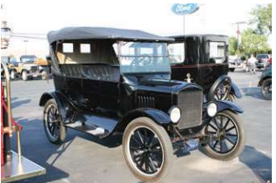
Historical Background (1 of 4)
From the early 1900s to the early 1930s, automobile design evolved from open horseless carriages to the basic design characteristics we see today.
Early vehicles were powered by electricity or steam.
Most bodies were open carriage designs.

Slide 5
Historical Background (2 of 4)
04-01 Explain the major events that have influenced the development of the automobile in the recent past.
1896 was the beginning of the automotive industry based on the Duryea Brothers making 13 cars from the first factory that produced these cars for consumers.
The way vehicles were build changed drastically with Henry Ford and the introduction of the Ford Model T which was the first to be built on an assembly line, making the car very affordable.
In the beginning, the automotive was designed to move people on dirt roads.

Slide 6
Historical Background (3 of 4)
The automobile changed when:
  Roads became paved.
  More people owned cars.
  Concerns for safety and the environment grew.
  New technologies were developed.
The results of the listed changes allowed the vehicle to become more practical, more affordable, safer, more comfortable, more dependable, and faster.
Many improvements have been made to the original design, but the basics have changed very little.

Slide 7
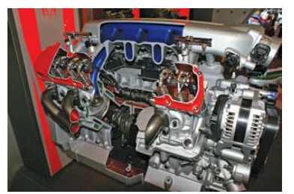
Historical Background (4 of 4)
The Corporate Average Fuel Economy (CAFE) standards were set in 1975 which pressed manufacturers to improve fuel economy.
While trying to produce more fuel-efficient vehi­cles, manufacturers replaced large eight-cylinder engines with four-cylinder and other small engines.
Basic engine systems like carburetors and ignition breaker points were replaced by electronic fuel injection and electronic ignition systems.

Slide 8
Design Evolution (1 of 2)
By the mid-1980s, all automobiles were equipped with some type of electronic control sys­tem.
These systems did, and still do, monitor the engine's operation and provide increased power outputs while minimizing fuel consumption and emissions.
Electronic sensors are used to monitor the engine and many other systems.
Computerized engine control systems control air and fuel deliv­ery, ignition timing, emission systems operation, and a host of other related operations.
The result is a clean-burning, fuel-efficient, and powerful engine.

Slide 9
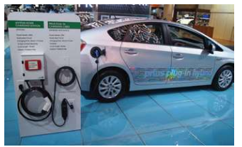
Design Evolution (2 of 2)
04.02 Explain how vehicle design has evolved with unitized vehicles and body-over-frame vehicles.
Not too long ago, nearly every car and truck was build with body-over-frame construction.
Today, most vehicles do not have a separate frame; instead, the frame and body are built as a single unity, called a unibody.
Most large pickup trucks and SUVs still use body-over-frame construction.

Slide 10
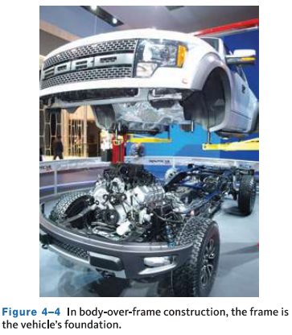
Body-Over-Frame Construction
The frame is an independent, separate com­ponent.
The body is generally bolted to the frame but large, specially designed rubber mounts are placed between the frame and body to reduce noise and vibration from entering the passenger compartment.
Some frames are made by a hydroforming process, which uses high­ pressure water, rather than heat, to shape the steel into the desired shape.

Slide 11
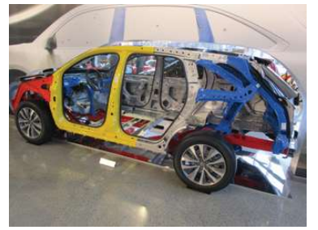
Unitized Construction
A unibody is a stressed hull structure in which each of the body parts supplies structural support and strength to the entire vehicle.
Unibody vehicles tend to be tightly constructed because the major parts are all welded together which helps protect the occupants during a collision.
Damage patterns that differ from those of body-over-frame vehicles. Rather than localized damage, the stiffer sections used in unibody design tend to transmit and distribute impact energy throughout more of the vehicle.

Slide 12
Knowledge Check (1 of 2)
Which of the following is likely safer for occupants in the case of a collision, an older full frame heavy car, or a newer unibody small car?

Slide 13
Knowledge Check Answer (1 of 2)
Which of the following is likely safer for occupants in the case of a collision, an older full frame heavy car, or a newer unibody small car? Why?
Answer: The newer unibody small car. Because the crumple zones in the body are designed to absorb impact rather than passing it on to the occupants.

Slide 14
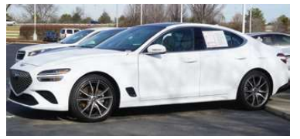
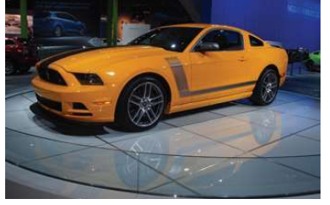
Body Shapes (1 of 2)
04.03 Identify body shapes.
Ten basic body shapes are used today:
  Sedan
  Convertibles
  Liftback or Hatchback
  Station Wagon

Slide 15
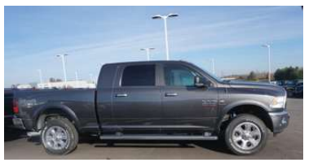
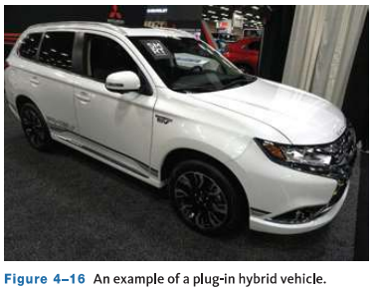
Body Shapes (2 of 2)
Ten basic body shapes are used today continued:
  Pickups
  Vans
  Sport utility vehicles (SUVs)
  Crossover vehicles
  Hybrid vehicles
  Electric vehicles

Slide 16
Discussion
You have learned the ten different body shapes in production currently.
Have a class discussion and provide example of vehicle make and model for each for the body types.

Slide 17
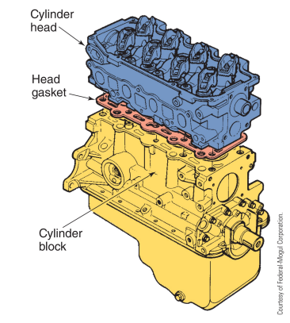
The Basic Engine
All automobile engines, both gaso­line and diesel, are classified as internal combustion engines because the combustion or burning of air and fuel mixture that provides the power to move the vehicle takes place inside the engine.
As a result of combustion, large amounts of pressure are generated in the engine. This pressure or energy is used to power the car. The engine must be built strong enough to hold the pressure and temperatures formed by combustion.

Slide 18
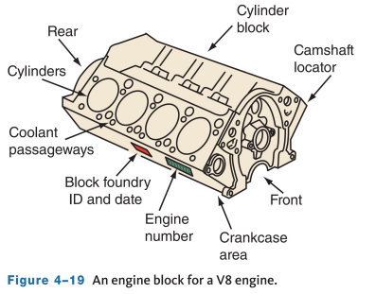
Cylinder Block
04.04 Identify the basic components of modern engines.
The biggest part of the engine is the cylinder block, which is also called an engine block.
The cylinder block is a large casting of metal (iron or aluminum) that is drilled with holes to allow for passage of lubricants and coolant within the block.
The block contains the cylinders, which are round passageways fitted with pistons. The block houses or holds the major mechanical parts of the engine.

Slide 19
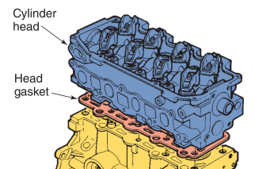
Cylinder Head
The cylinder head fits on top of the cylinder block to close off and seal the top of the cylinders and can be made of cast iron or aluminum.
The combustion chamber is an area into which the air–fuel mixture is compressed and burned. The cylinder head contains all or most of the combustion chamber.
The cylinder head also contains ports, which are passageways through which the air–fuel mixture enters and burned gases exit the cylinder.

Slide 20
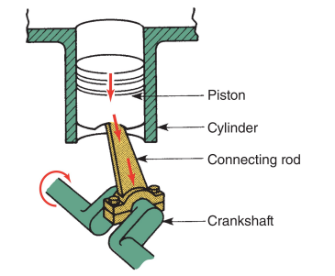
Piston, Connecting Rod, Crankshaft
The piston is a can-shaped part closely fitted inside the cylin­der.
As the piston is pushed down on the power stroke, the connecting rod pushes on the crankshaft, causing it to rotate.
As the piston travels up and down, it completes a cycle, and this type of engine requires 4 of these cycles to produce the power stroke or combustion stroke.

Slide 21
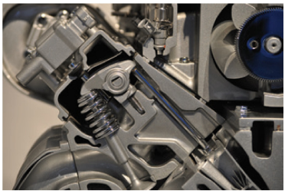
Valve Train
A valve train is a series of parts used to open and close the intake and exhaust ports.
A valve is a movable part that opens and closes a passageway.
A camshaft controls the movement of the valves causing them to open and close at the proper time.
Springs are used to help close the valves.

Slide 22
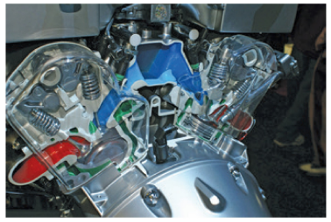
Manifolds
A manifold is a ductwork assembly used to direct the flow of gases to or from the combustion cham­bers.
Two separate manifolds are attached to the cylinder head.
The intake manifold delivers a mixture of air and fuel to the intake ports.
The exhaust manifold mounts over the exhaust ports and carries exhaust gases away from the cylinders.

Slide 23
Engine Systems
04.05 List the basic systems that make up an automobile and name their major components and functions.
The following sections present a brief explanation of the systems that help an engine run and keep running.
  Lubrication System
  Cooling System
  Fuel and Air System
  Emission Control System
  Exhaust System
  Ignition System
  Starting and Charging Systems
  Electronic Engine Controls
  On-Board Diagnostics

Slide 24
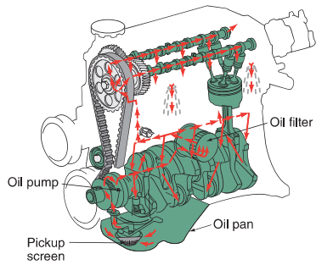
Lubrication System
The moving parts of an engine need constant lubri­cation.
Lubrication limits the amount of wear and reduces the amount of friction in the engine.
Motor or engine oil is the fluid used to lubricate the engine.
Oil from the pan passes through an oil filter before moving through the engine which removes dirt and metal particles.

Slide 25
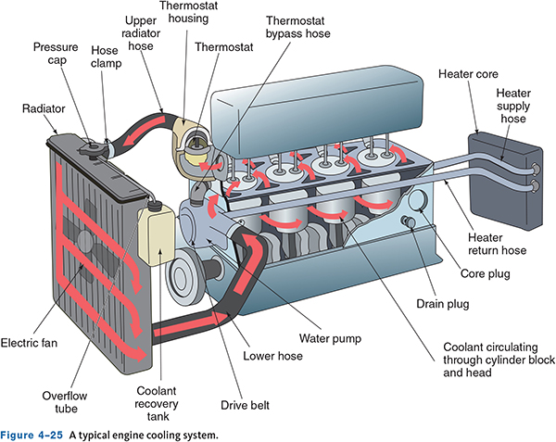
Cooling System (1 of 2)
The combustion of the air–fuel mixture produces large amounts of heat in the engine.
This heat must not be allowed to buildup and must be reduced because it can damage and warp engine parts.
To prevent this, engines have a liquid cooling system which circulates a liquid coolant through passages in the engine block and cylinder head.

Slide 26
Cooling System (1 of 2)
A typical cooling system relies on a water pump, which circulates the coolant through the system and is driven by a pump or electric motor.
The cool­ant is pushed through passages, called water jackets, in the cylinder block and head to remove heat from the area around the cylinders.
The heat picked up by the coolant is sent to the radiator which trans­fers the heat to the surrounding air.
To raise the boiling point of the coolant, the cool­ing system is pressurized and to maintain this pressure, a radiator cap or pressure cap is fitted to the radiator.
A thermostat is used to block off circulation in the sys­tem until a preset temperature is reached which allows the engine to warm up faster.

Slide 27
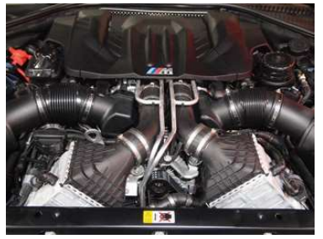
Fuel and Air System
The fuel and air system is designed to supply the cor­rect amount of fuel mixed with the correct amount of air to the cylinders of the engine.
The air system collects and cleans the outside air, then delivers outside air to the individual cylinders.
A fuel tank stores the liquid gasoline.
Fuel lines carry the liquid from the tank to the other parts of the system. A pump moves the gasoline from the tank through the lines.

Slide 28
Emission Control System
Today's gasoline engines have been engineered to emit very low amounts of certain pollutants.
The pollutants that have been drastically reduced are hydrocarbons (HC), carbon monoxide (CO), and oxides of nitrogen (Nox).
The Environmental Pro­tection Agency establishes emissions standards that limit the amount of these pollutants a vehicle can emit.
Common components or systems used include; Positive crankcase ventilation (PCV), Evaporative emission control system, Exhaust gas recirculation (EGR) system, Catalytic converter, and the Air injection system.

Slide 29
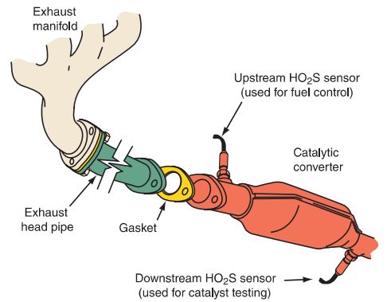
Exhaust System
During the exhaust stroke, the engine's pistons push the burned air–fuel mixture, or exhaust, out of the cylinder and into the exhaust manifold.
From the manifold, the gases travel through the exhaust system until they are expelled into the atmosphere.

Slide 30
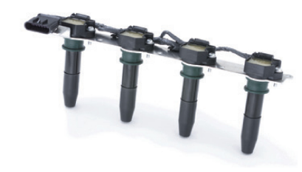
Ignition System
A gasoline engine uses an electrical spark to ignite the air fuel mixture, and generating this spark is the role of the ignition system.
The ignition coil generates the electricity that creates the spark.
The voltage jumps across a gap between two elec­trodes at the end of each spark plug and causes a spark.

Slide 31
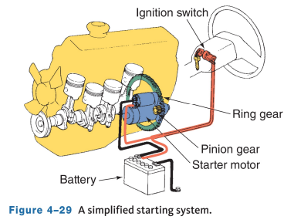
Starting Systems
The starting system is responsible for starting the engine.
When the ignition key is turned to the start position or the START button is pressed, a small amount of current flows from the battery to a solenoid or relay.
The starter then engages in the engine's flywheel, which is attached to the engine's crankshaft, and spins it.

Slide 32
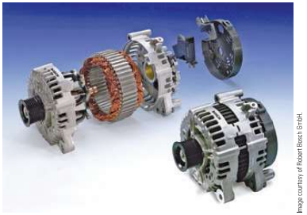
Charging Systems
The charging system is designed to recharge and maintain the battery's state of charge.
The charging system includes an AC generator (alternator), voltage regulator, indicator light, and the necessary wiring.
Rotated by the engine's crankshaft through a drive belt, the AC generator converts mechanical energy into electrical energy.

Slide 33
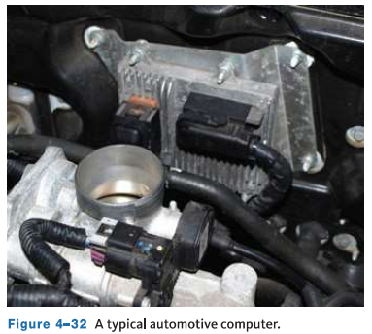
Electronic Engine Controls
Nearly all vehicles have an electronic engine con­trol system.
This system is comprised of many elec­tronic and electromechanical parts.
It is designed to continuously monitor the engine and to make adjustments.
Electronic control systems have three main types of components: input sensors, a computer, and out­put devices.

Slide 34
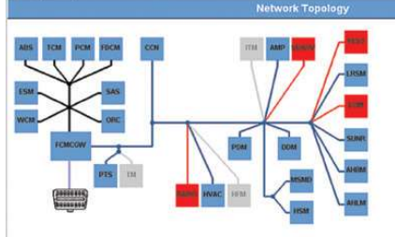
On-Board Diagnostics
Today's engine control systems are on-board diag­nostic (OBD II) second-generation systems.
When the OBD system determines that a prob­lem exists, a corresponding "diagnostic trouble code" is stored in the computer's memory.
The computer can detect system problems even before the driver notices.

Slide 35
Knowledge Check (2 of 2)
What system is responsible for igniting the air fuel mixture in an engine? And what component generates the electricity for the spark?

Slide 36
Knowledge Check Answer (2 of 2)
What system is responsible for igniting the air fuel mixture in an engine? And what component generates the electricity for the spark?
Answer: The ignition system. The ignition coil generates the electricity that creates the spark.

Slide 37
Heating and Air-Conditioning Systems
Heating and air-conditioning systems do little for the operation of a vehicle; they merely provide com­fort for the vehicle's passengers.
To meet federal safety standards, all vehicles must be equipped with passenger compartment heating and windshield defrosting systems.
The main com­ponents of an automotive heating system are the heater core, the heater control valve, the blower motor and the fan, and the heater and defroster ducts.
The heating system works with the engine's cooling system and converts the heat from the cool­ant circulating inside the engine to hot air, which is blown into the passenger compartment.

Slide 38
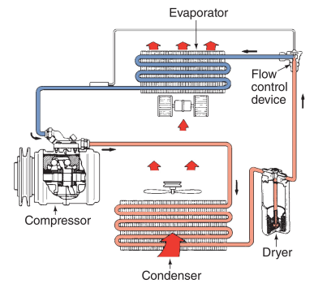
Air-Conditioning Systems
In an automotive air-conditioning (A/C) system, heat is removed from the passenger compartment and moved to the outside of the vehicle. The substance used to remove heat is called the refrigerant.
An A/C system is a closed, pressurized system. It consists of a compressor, condenser, receiver/ dryer or accumulator, expansion valve or orifice tube, and an evaporator.

Slide 39
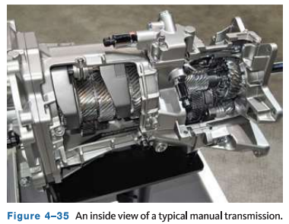
Drivetrain
The drivetrain is made up of all components that transfer power from the engine to the driving wheels of the vehicle.
A transmission is found in RWD vehicles. Transax­les are used in FWD vehicles. Both provide various drive gears that allow the vehicle to move forward and in revers.
A clutch is used with manual transmissions/ transaxles. It mechanically connects the engine's flywheel to the transmission/transaxle input shaft.

Slide 40
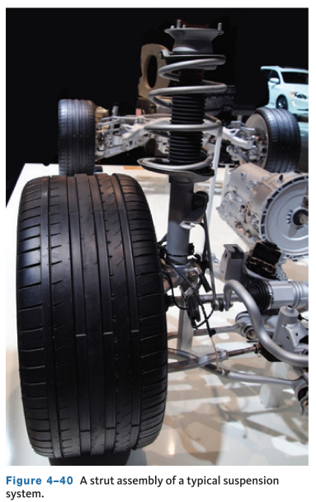
Suspension System
The suspension system is normally comprised of such components as the springs, shock absorbers, MacPherson struts, torsion bars, axles, and connecting linkages.
Springs or torsion bars are used to support the axles of the vehicle.
Shock absorbers dampen the upward and downward movement of the springs.

Slide 41
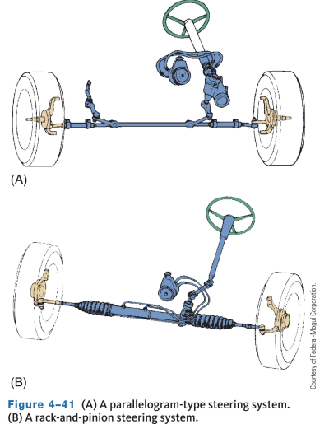
Steering System
The steering system allows the driver to control the direction of the vehicle. It includes the steering wheel, steering gear, steering shaft, and steering linkage.
Two basic types of steering systems are used today: the rack-and-pinion and recirculating ball systems.
Steering gears provide a gear reduction and power assist to make changing the direction of the wheels easier and may be hydraulic or electric powered.

Slide 42
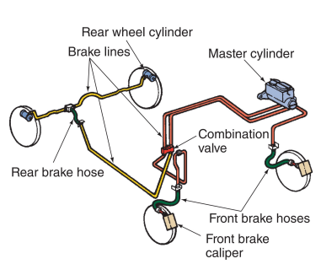
Brakes
Brakes, located at each wheel, use friction to slow and stop a vehicle.
The brakes are activated when the driver presses down on the brake pedal which is con­nected to a plunger in a master cylinder, and transferred through brake hoses and lines to the four brake assemblies.
Two types of brakes are used, disc brakes and drum brakes.
Most vehicles have power-assisted brakes, many vehicles use a vacuum brake booster.

Slide 43
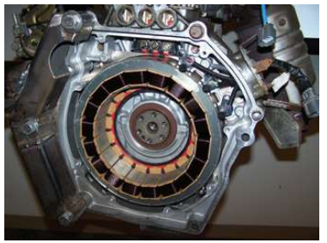
Hybrid Vehicles (1 of 2)
04.06 Explain how hybrid and electric vehicles differ from standard combustion-powered vehicles.
A hybrid electric vehicle (HEV) uses one or more electric motors and an engine to propel the vehi­cle.
Depending on the design of the system, the engine may move the vehicle by itself, assist the electric motor while it is moving the vehi­cle, or it may drive a generator to charge the vehi­cle's batteries.

Slide 44
Hybrid Vehicles (2 of 2)
The electric motor may power the vehicle by itself or assist the engine while it is pro­pelling the vehicle.
Because of the current fuel economy and emission regulations set by the government, auto manufacturers are introducing a variety of battery-operated electric vehicles.
In 2021, about 430,000 electric vehicles were sold in the United States. Sales are expected to increase as more models of electric vehicles become available.
The Electric Vehicles do not have an internal combustion engine like a hybrid, they are battery powered only with zero emissions and must be charged by an external source such as a charging station or home charging unlike a hybrid.

Slide 45
Alternative Fuels
04.07 List the types of alternative fuels available for transportation.
By using alter­native fuels, we not only reduce our reliance on oil but we reduce emissions and the effects an auto­mobile's exhaust has on global warming. Common alternative fuels are:
  Propane, also referred to as liquefied petroleum gas (LPG)
  Methyl alcohol, normally called Methanol
  Ethyl alcohol, also referred to as Ethanol
  Compressed natural gas (CNG)

Slide 46
Chapter Reflection
Please take a moment to compare your perception of the automotive industry before and after you studied this chapter. Then respond to the following questions in one or two paragraphs. Use 150–200 words in your reflection.
Did anything in this chapter change your thinking about the different automotive systems? Describe the systems that interest you most.
Considering all you have learned, do you feel you are able to apply your new understanding of automotive systems to your daily work or class activities?

